Slide 1





Near Infra-red and RFID Assay for Glucose monitoring By GLUCO WATCH
4844
RASHMI RANJAN
JENA
DISHA SWAIN
UJJWAL DASH
ATIRIJYA BHUYAN
Veer Surendra Sai University of Technology, Burla
Sambalpur

Slide 2
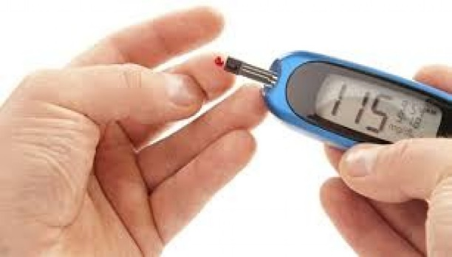
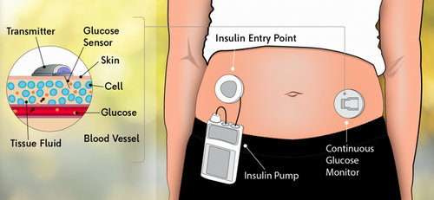
Challenge Statement
Diabetes is a severe metabolic disorder that presently has no cure. Diabetes is mainly caused by irregular blood glucose levels, with limited treatment options including taking insulin orally or by injection. The Diabetes Control and Complications Trial (DCCT) shows that frequent testing of blood glucose levels improves the quality of life. The blood glucose self-monitoring market is the largest market for medical products, with a size of USD 209 million in India and $18.10 billion worldwide.
Usually, in a continuous glucose monitoring system, sensors are implanted subcutaneously to measure the glucose levels in the interstitial fluids over various intervals of time throughout the day, providing data that shows trends in glucose measurements over short intervals of time. These sensors can be painful during insertion and usually require the assistance of medical staff. These sensors can only be used for short durations and often lead to infections.
Therefore, our main focus is:
to develop a viable innovative solution to overcome the barrier of periodic testing
INVASIVE GLUCOSE MONITORING METHODS
4844

Slide 3
Concept of the solution
We are developing a non-invasive glucose monitoring device using NIR spectroscopy sensor, Arduino Nano and Blynk app for displaying data. The device is designed to measure the glucose level in the blood without requiring a blood sample.
The NIR spectroscopy sensor uses near-infrared light to penetrate the skin and detect the glucose level in the blood. The Arduino Nano is used to collect the data from the sensor and send it to the Blynk app, which displays the glucose level on a mobile device.
In addition, the prototype incorporates machine learning (ML) algorithms to predict the possibility of diabetes for individuals based on their glucose levels. The ML algorithms are trained using a dataset of glucose levels and corresponding diabetes status.
Based on the prediction of diabetes, the prototype recommends suitable diet plans for individuals. The recommended diet plans are generated based on the individual's glucose level and other health factors such as age, weight, and activity level.
Overall, the solution for the prototype involves the integration of NIR spectroscopy sensor, Arduino Nano, Blynk app, and ML algorithms to provide a non-invasive and accurate method of measuring glucose levels in the blood, predicting diabetes and recommending personalized diet plans for individuals.
4844

Slide 4
Scope of the solution
The scope of the above prototype is quite significant, as it has the potential to revolutionize the way glucose levels are monitored for individuals with or at risk for diabetes.
Firstly, the prototype offers a non-invasive method of measuring glucose levels, which eliminates the need for painful and invasive blood tests. This can make it more comfortable for individuals to monitor their glucose levels and encourage them to do it more frequently.
Secondly, the incorporation of machine learning algorithms in the prototype can provide a more accurate prediction of diabetes based on the individual's glucose levels. This can help identify individuals at risk for diabetes earlier, which in turn can lead to earlier intervention and prevention of diabetes-related complications.
Thirdly, the prototype's ability to recommend personalized diet plans can aid in diabetes management and improve an individual's overall health. By providing tailored recommendations based on an individual's glucose levels and other health factors, the prototype can help individuals make informed dietary choices and maintain better control over their glucose levels .
Overall, the prototype has a vast scope for use in healthcare and can significantly improve diabetes management for individuals, especially those with type 2 diabetes who may benefit from lifestyle modifications such as diet changes
4844

Slide 5
SWOT Analysis
STRENGTH
WEAKNESS
non-invasive feature
It is easier to use because it does not require medical intervention.
low-cost and compact
quicker response time, improved stability, usability, and accuracy
To enhance the accuracy of glucose measurement, a calibration algorithm was applied to the data processing of the watch.
It requires charging or battery replacement.
It is now larger in size because it is still in the prototype stage, but it will be reduced to a single watch in the future.
OPPORTUNITIES
THREATS
Non-invasive measurement: The use of NIR spectroscopy sensor provides a non-invasive way of measuring glucose levels in the blood, which can increase patient compliance and reduce the risk of infection.
Accurate measurement: The integration of ML algorithms can enhance the accuracy of the glucose level measurement and improve the precision of the recommendations.
Personalized diet plans: The use of ML algorithms can also enable the prototype to recommend personalized diet plans for individuals based on their glucose level measurements.
Remote monitoring: The use of the Blynk app can allow for remote monitoring of glucose levels and diet plans, enabling individuals to manage their health and wellness more effectively.
Accessibility: The cost and availability of the prototype may limit its accessibility to individuals who need it the most, particularly in low-income or underserved communities.As the product is still in prototype stage so the price is more as the sensors used are multipurpose in nature but when it will be manufactured in bulk the price will reduce significantly and it will also be integrated in chips for specific purpose.
Regulatory approval: The prototype may require regulatory approval before it can be used in clinical settings, which can be a time-consuming and expensive process.
4844

Slide 6
Implementation (1/2)
For on-body testing, the NIR glucose sensor is fixed over the wrist or at the tip of the finger. The workflow of the system in Arduino IDE states that the calibration value obtained from the sensor patch which is connected at one of the channels as its work range varies around 860nm(favourable range for measurement of data) is the first input data into the system from the low-cost microcontroller chip NodeMCU integrated with the esp32 built-in module to execute the calibration algorithm wirelessly via Wi-fi and accurately confirm the output readings. Then, output values are transferred to the Blynk server console setup through a gauge meter and which reads the signal output for the measurement in Volts. This is further processed by AI/ML technology resulting in the corresponding output in mg/dl per blood glucose level concentration. Finally, the numerical blood glucose result is displayed on the OLED screen and also maybe sent to the user’s smartphone. The patient wears the watch for approximately 10 h during the day, and the blood glucose fluctuation measured by the watch was recorded.
•The blood glucose levels measured by the watch, especially the peaks, accurately reflect the trend of the patient’s true blood glucose levels.
•To evaluate the accuracy of glucose measurements by the watch with a Beer-lambert law and the Clarke error grid was plotted using the measurement results.
•To verify that daily body motions do not impair the sensing performance of the watch, we compared the measurement results from two watches, one worn on a static arm and the other on a moving arm.
4844

Slide 7
Implementation (2/2)
Spectroscopy: Spectroscopy is classified according to the wavelengths of the electromagnetic spectrum, such as IR-spectroscopy, UV spectroscopy, and so on.In the proposed model, we used NIR spectroscopy.
NIR Spectroscopy:The concept of near infrared (NIR) spectroscopy is based on the absorption of electromagnetic radiation (EM) at wavelengths ranging from 780 to 2,500 nm. During light interaction with the sample, a detector measures its transmittance and absorbance. NIR spectroscopy is interested in both electronic and
vibrational transitions and determines the date by analysing variations in reflected signal intensity. A NIR spectrophotometer measures light scattered off and through sample materials, enabling quick and accurate evaluation of their properties.
Versatility of NIR Spectroscopy: In many ways, NIR spectroscopy is extremely versatile. First and foremost, it is extremely versatile in its applications. NIR spectroscopy can be used in a laboratory, a factory, a hospital, a field, and a field laboratory.
REGRESSION:
Regression is a statistical method used to investigate and examine the nature and strength of the relationship between one variable (usually denoted by Y).
Quadratic regression which allows simulation of a relationship between two sets of independent variables and used to determine which parabola equation is most conducive to fitting a set of data.
The general form of a quadratic equation is y=a*x2+b*x+c, where a=0.
The R2 model is another name for it
4844

Slide 8
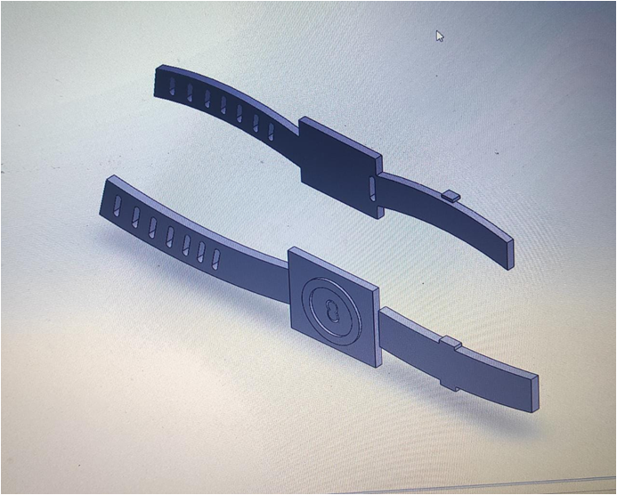
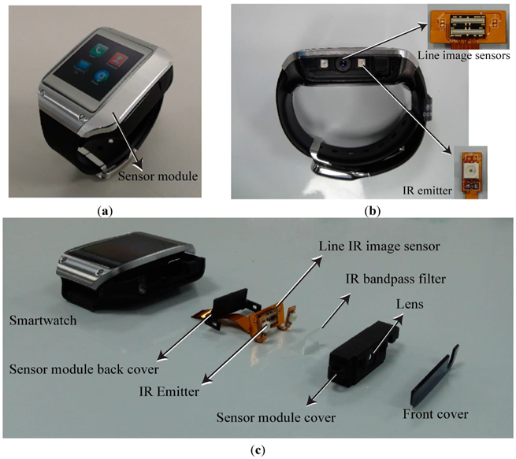
Testing / Analysis (1/2)
The CAD Model of the watch is designed by using Solid works
4844

Slide 9
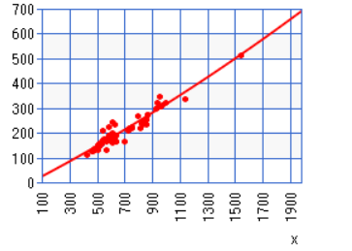
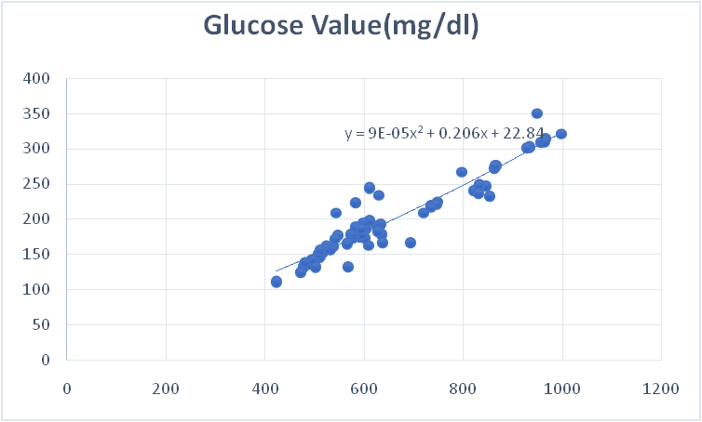
Testing / Analysis (2/2)
Analog Voltage(mV) | Glucose Value(mg/dl)
499 | 142
509 | 146
519 | 156
519 | 157
548 | 177
524 | 159
543 | 209
568 | 133
573 | 179
583 | 224
592 | 175
597 | 187
607 | 196
627 | 191
695 | 167
735 | 220
612 | 244
847 | 247
833 | 248
Quadratic Regression plot and Equation derived using AI/ML on samples measured data of individuals
4844

Slide 10

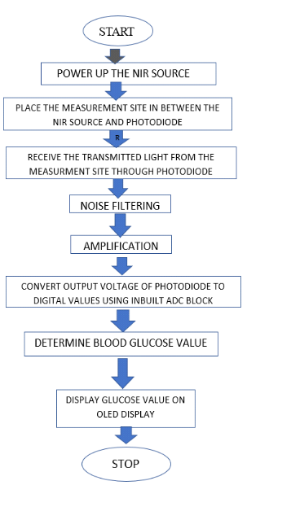
POC Demo and Flowchart
4844

Slide 11
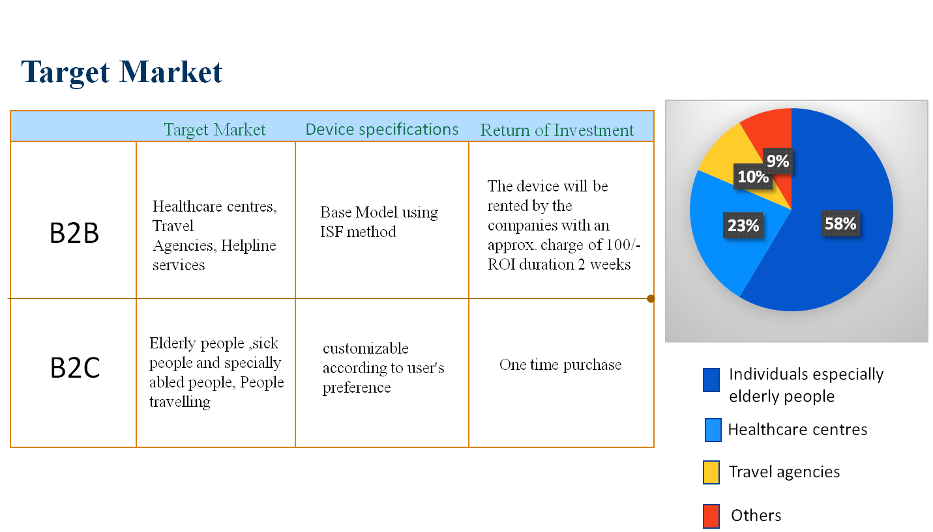
High Level plan for converting POC to MVP
4844

Slide 12
Cost for POC vs MVP
Cost for Developing POC
Approximate cost for POC to MVP
The components used in the prototype stage project are few in number, reliable and have longer lifespan. The required components along with the price are listed below.
The results show that our proposed model
or proposed approach when compared with the traditional method it gives roughly around 0.5-2 % of error in the values.
As the product is still in prototype stage so the price is more as the sensors used are multipurpose in nature but when it will be manufactured in bulk the price will reduce significantly and it will also be integrated in chips for specific purpose.
Our minimum viable product MVP include UNIQUE and quick operation features that make your solution valuable for the customers based upon -
Our target audience
The advantage of your solution
Our validation criteria
The part of the product development that needs verification
Our product accessible at web.APP/IOS.
An estimated budget, timing and resources
Your vision of target output as for product readiness and functionality.
Costing will sum upto 2000/- which measures glucose,Spo2,HEART rate,temp,etc.
SL.No | Components | Quantity | Cost/pc | Overall cost
1 | NIR Sensor | 1 | Rs 2500.00 | 2500.00
2 | PCB circuit | 1 | Rs 200.00 | 200.00
3 | Node MCU | 1 | Rs 350.00 | 350.00
4 | Photodiode | 1 | Rs 20.00 | 20.00
5 | Op-Amp | 1 | Rs 40.00 | 40.00
6 | LCD | 1 | Rs 200.00 | 200.00
7 | 3.3 V Battery | 1 | Rs 35.00 | 35.00
The final cost would sum up to Rs 3200 /- for designing GLUCO watch for 3.3V 12h battery and it is one stop solution for all vital health parameters
4844

Slide 13
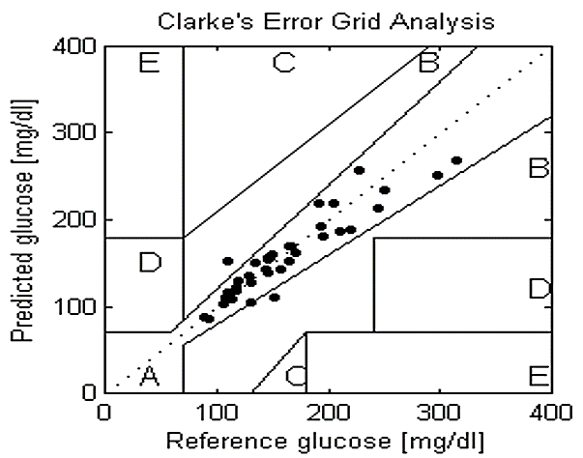
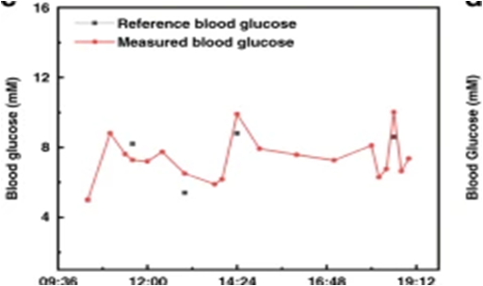
Result / Conclusion
An innovative non-invasive portable blood
glucose computing devices is effective way to manage diabetic patients' health, this blood glucose
monitor is portable,low-cost,user-friendly,stabilized and accurate.
Region A:
The difference between meter values and reference values is less than 20%.
Region B:
The difference between meter values and reference values is larger than 20%.
Region C:
Large correction and difference in values leads to unnecessary treatment.
Region D:
Values indicating a potentiality dangerous failure to detect hypoglycaemia or hyperglycaemia.
Region E:
Values that would confuse treatment of hypoglycaemia for hyperglycaemia and vice versa.
4844

Slide 14
References
•https://www.news-medical.net/whitepaper/20171103/Non-Invasive-Blood-Glucose-Measurement-using-IR-Spectroscopy.aspx
•https://link.springer.com/article/10.1007/s11277-018-5906-z
•https://robocraze.com/blogs/post/ir-sensor-working

Slide 15

THANKING YOU

